Slide 1
SmartChair
Group 10
Angelo Biaggi
Trent Gallagher
Ryan Pearce
Lomar St.Louis

Slide 2
Summary
The SmartChair is a safety and security-enhanced wheelchair.
It takes a typical, everyday manual wheelchair and turns it into a transportation device that takes advantage of modern technology.
Targeted primarily towards elderly users.
Can be locked to be left unattended, only unlocked by a unique RFID key.
Has a GPS tracker which uses GSM so data can be received in most places around the world.
Pressure pads detect when the user is getting in or out of the chair, and will automatically lock the wheels.
LCD screen displays basic information to the user.

Slide 3
RFID Technology Comparison
“Cost” is referring to the tags, however for a single receiver/scanner combo, LF was much cheaper.

Slide 4
RFID Receiver Overview
4 Pins
VCC (+5V)
GND
/ENABLE (input)
SOUT (output)
Small size, efficient
Allows for convenient placement on the wheelchair
Low power use when scanning, and almost-zero power use when not scanning.

Slide 5
RFID Receiver Overview
/ENABLE Flag (input)
HIGH = Scanner is off, power consumption is down.
LOW = Scanning actively for keys and passing them out serially to the SOUT line
SOUT
Data is transmitted at 5V over serial communication.

Slide 6
RFID Receiver Overview
SOUT (continued)
Transfer protocol
Communication | Serial
Data bits | 8
Stop bits | 1
Parity | No
Bit Order | Least significant bit first
Transfer speed | 2400 bps
Signal | 5V TTL-level, non-inverted asynchronous serial

Slide 7
RFID Receiver Overview
SOUT (continued)
12 bytes transferred from a key read
Middle 10 bytes are ASCII characters
Start byte is 0x0A , NewLine
End byte is 0x0D, Carriage Return

Slide 8
RFID Receiver Overview
LED
Along with the RFID lock/unlock system will be a simple LED that changes colors based on the current state:
LED Color | Meaning | Occurs When
GREEN | Idle state - Not searching | /ENABLE port is either HIGH or disconnected
RED | Actively searching for RFID key | /ENABLE is LOW
Blank | No power | VCC is low or disconnected

Slide 9
RFID Receiver Overview
DC Characteristics of RFID Receiver

Slide 10
RFID Receiver Overview
Maximum Ratings of RFID Receiver
They are well within the conditions of most human-populated areas of the world

Slide 11
RFID Tag Overview
Passive Key used with Low Frequency RFID technology.
Reliable
Has no battery requirement, should function well beyond any user’s needs.
Works by harvesting the energy from the receiver transmission, modulating it, and transmitting back the unique ASCII code of the key.

Slide 12
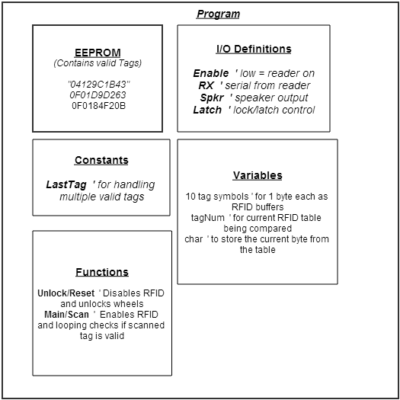
RFID Software Overview
Reads tags from the RFID receiver and compares them to a list of known/accepted tags.

Slide 13
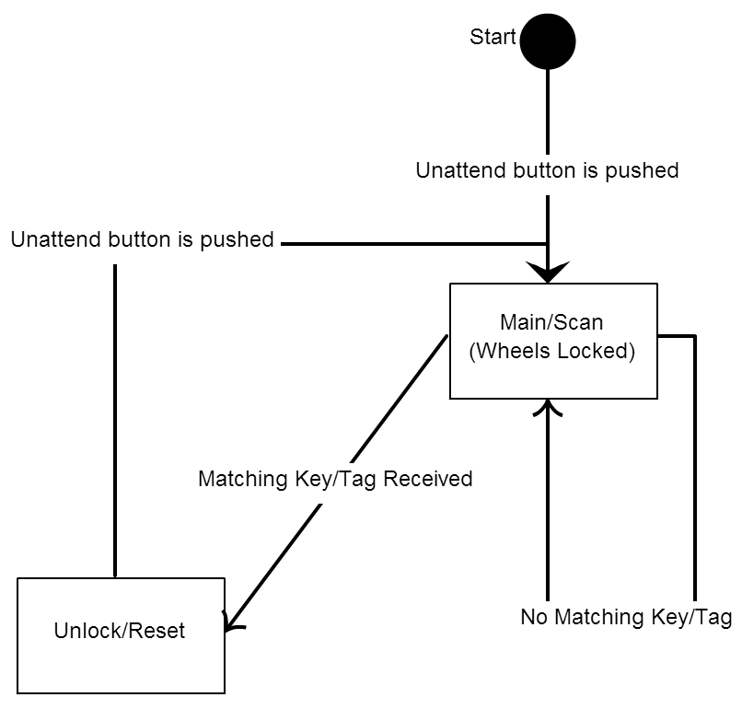
Unattended Mode (Device Locked)
An “unattended mode” button is pushed to lock the device.
Before the Main/Scan loop occurs
The motor is sent a signal to lock the wheels
The RFID receiver is set to active (by setting /ENABLE to LOW), which causes the LED to turn red
The LED being red will be a clear indicator that the wheelchair is locked

Slide 14
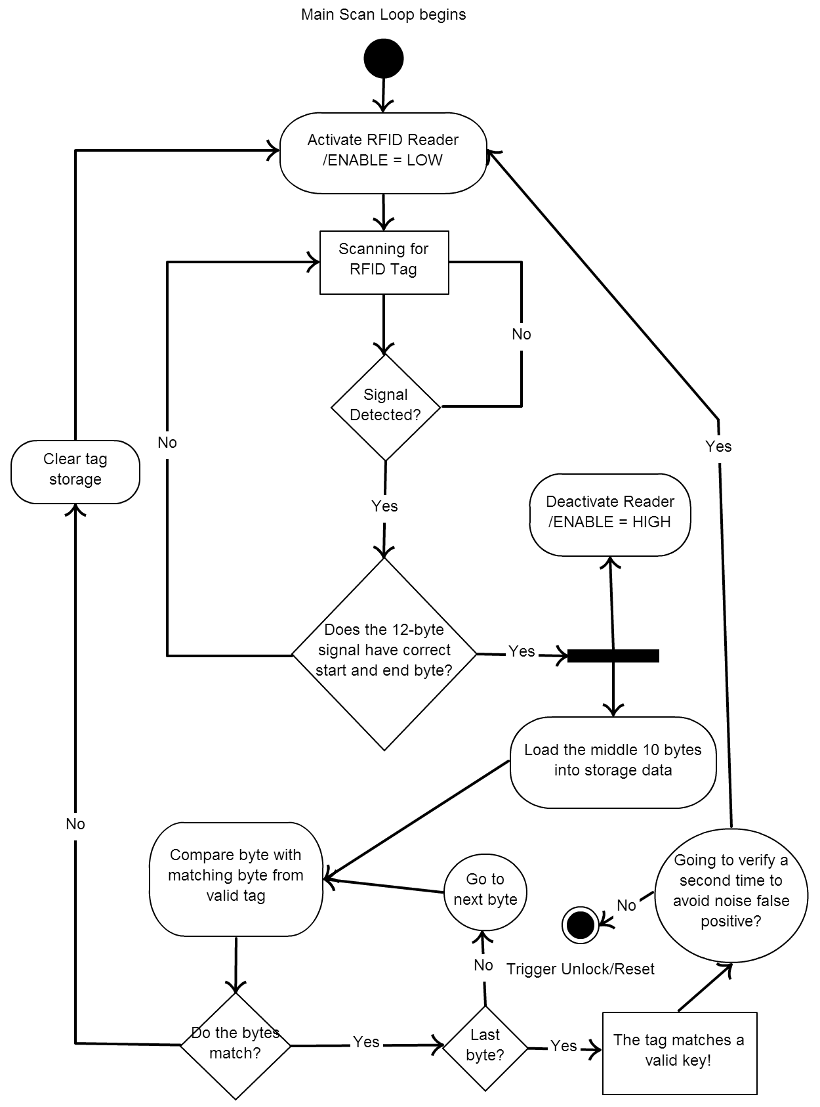
Main Scanning Loop
When a 12-byte set is registered that has the correct start and end bytes, the middle 10 bytes are compared against each valid key listed in the EEPROM.
This continues until a match is found, at which point the device unlocks.

Slide 15
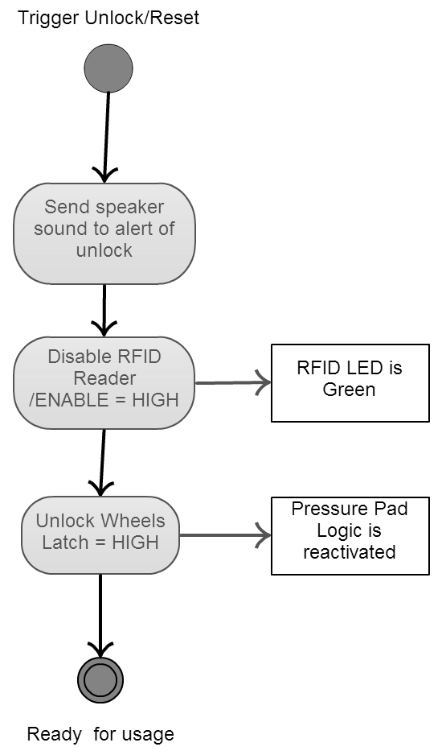
Unlock/Reset
Speaker sound (may be removed)
LED turns green to notify of unlocked state
Wheels are unlocked
Pressure Pad logic is reactivated

Slide 16
FlexiForce A201 & A401 Sensors
Specifications
 | A201 | A401
Thickness | 0.208 mm | 0.208 mm
Length | 197 mm | 56.8 mm
Width | 14 mm | 31.8 mm
Sensing Area | 9.53 mm diameter | 25.4 mm diameter
Connector | 3-pin Male Square Pin | 2-pin male square pin
Substrate | Polyester | Polyester
Pin Spacing | 2.54 mm | 2.54 mm
Linearity Error | < ±3% | < ±3%
Repeatability | < ±2.5% of full scale | < ±2.5% of full scale
Hysteresis | < ±4.5% of full scale | < ±4.5% of full scale
Drift | < 5% per logarithmic time scale | < 5% per logarithmic time scale
Response Time | < 5 microseconds | < 5 microseconds
Operating Temperatures | -40°C – 60°C | -40°F – 140°F
Force Ranges | 4.4 N, 110 N, 440 N | 0 – 1 lb, 0 – 25 lb, 0 – 100 lb
Temperature Sensitivity | Output variance of 0.2% per degree | Output variance of 0.2% per degree

Slide 17
How to Adjust Force Range

Slide 18
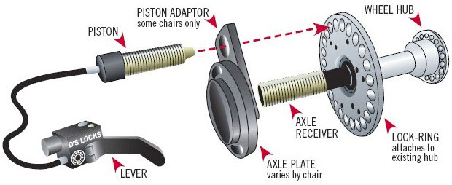
Piston Driven Actuator
Disadvantage
Immediate harsh braking
Notes:
If for any reason at least one of the piston driven actuators does not fire correctly and on time, it would result in the safety enhanced wheelchair moving backwards or rotating around while the person using the safety enhanced wheelchair is trying to get out of it.

Slide 19
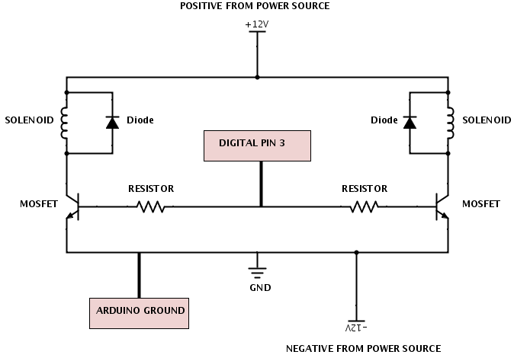
Locking Mechanism

Slide 20
Solenoid
Specifications
Type | Box Frame
Stroke Range | 1/8 in to 1 in
Pull Force Range | 20 oz to 130 oz
Width | 1.5625 in
Depth | 1.625 in
Length | 2.1875 in
Coil Volts | 12 DC
Seated Amps | 2.6 A
Seated Watts | 32.3 W
Coil Resistance | 4.68 Ω
Price | $54.70
Coil Insulation | Class 105
Terminals | Solder Lug
Duty Cycle | Intermittent
Materials of Construction | Steel
Standards | UL, RoHS
Mountng Holes | 8-32 UNC-2B

Slide 21
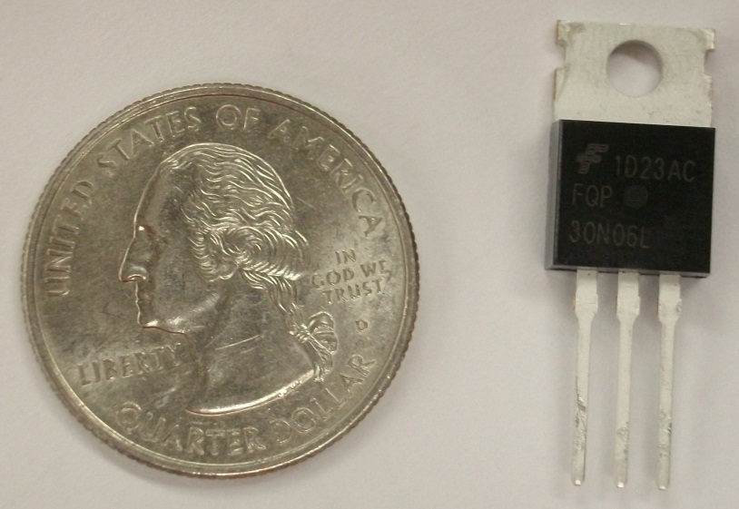
N-Channel Mosfet
Specifications
Model | FQP30N06L
Drain-Source Voltage | 60 V
Drain-Source Current | 32 A
Gate-Source Voltage | ± 20 V
Power Dissipation | 79 W
Gate Threshold Voltage | 1 V – 2.5 V
Operating Temperature Range | -55°C – 175° C
Switching Turn-On Delay Time | 15 – 40 ns
Switching Turn-Off Delay Time | 60 – 130 ns
Notes:
Also mention diode specs and resistor specs

Slide 22
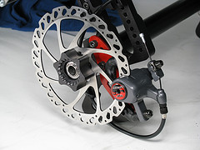
Cable Disc Brakes
Product Specifications
Mechanical two piece forged aluminum calipers
Tri-align caliper positioning
Dual knob pad adjustment
Weighs only 329 grams
G2 CleanSweep rotors
Sintered pads
Advantages
Durable
Light weight
Cost effective
Simple installation
Reliable in all weather conditions

Slide 23
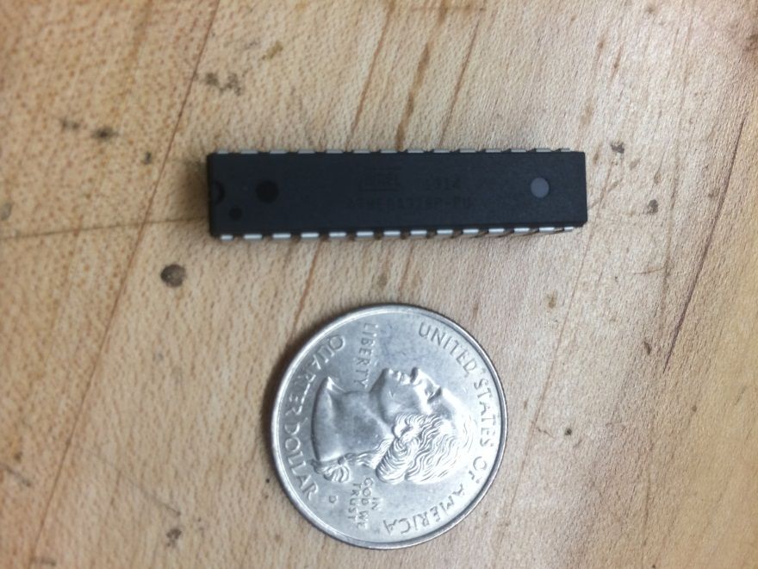
ATmega328 Microprocessor
Contains all code for the system
Operating Voltage 1.8 to 5.5 Volts
Memory: 32 Kb
Low cost: $2.88

Slide 24
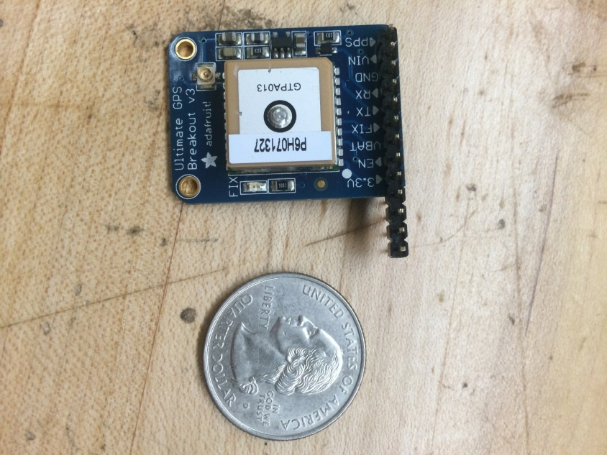
GTPA013 GPS Module
Fast TTFF: 34 seconds from cold start
Operating Voltage: 3.0-5.5 V
Supports up to 22 satellites
Uses NMEA 0183 protocol
Small and compact : 15X15X4 mm
Price: 39.95

Slide 25
GPS Functions
Will contiguously update coordinate location
When event triggered GPS data is parsed
Only latitude and longitude will be used

Slide 26
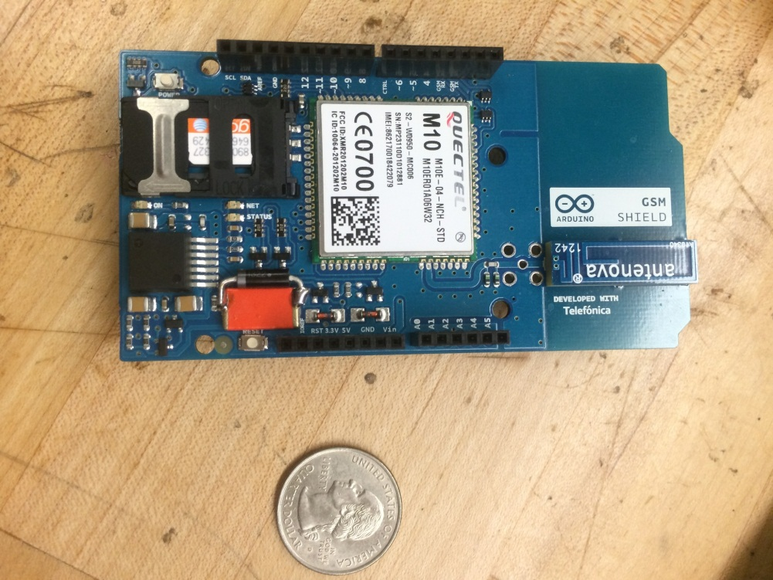
M10 GSM Module
Operating Voltage: 3.3 – 5.5 V
Current consumption as low as1.2mA
Has GPRS capabilities
AT Commands used
Affordable: $39.95
M2M data plan required

Slide 27
GSM Functions
Will receive a SMS
Once text message is received GPS coordinates dates are parsed
SMS will be sent out by module containing coordinates

Slide 28
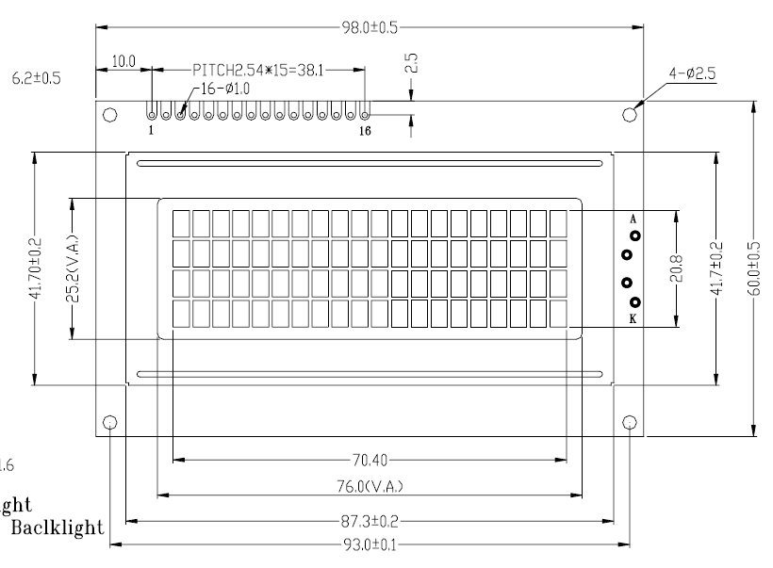
LCD SCREEN
Character type
Low Cost
Not graphical difficult to Program
Best type based on Project
16 X 2

Slide 29
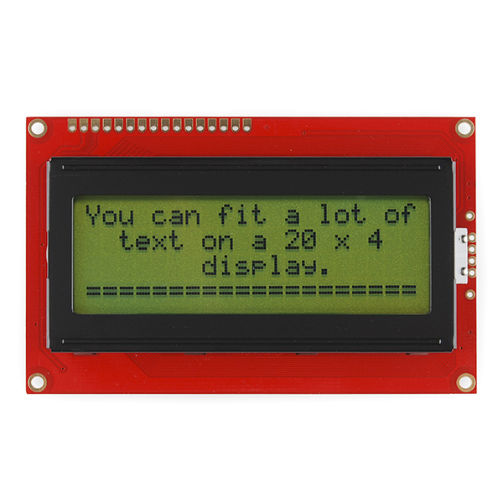
LCD Screen Function
Provide power levels from circuit
Displays if locking mechanism is Locked/ Unlocked

Slide 30
LCD DIAGRAM

Slide 31
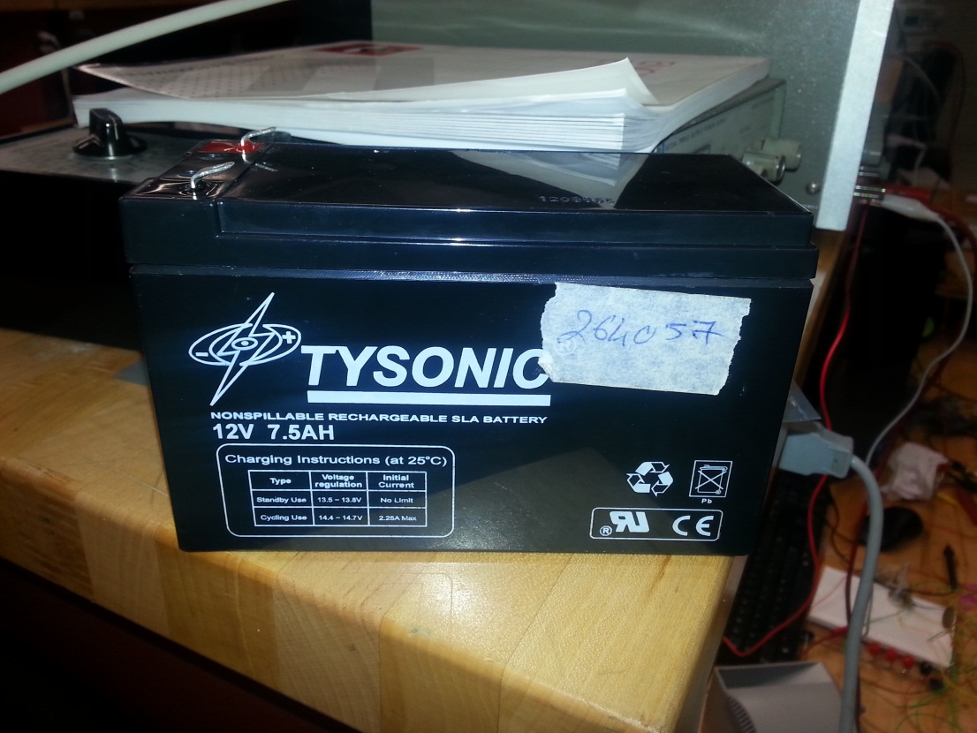
Lead Acid Battery
Excellent Time Durability
Excellent Life Durability
High Charge efficiency
Very Cost Effective
12V

Slide 32
Power

Slide 33
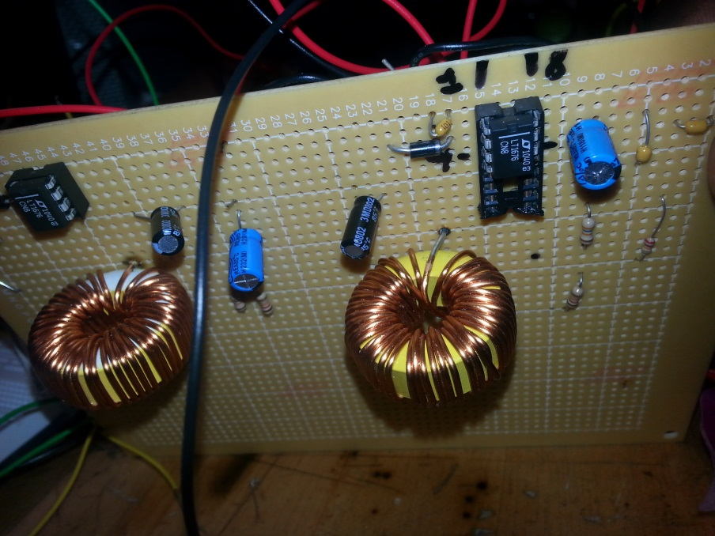
Printed Circuit Board

Slide 34
Budget
Item | Unit Price | Quantity | Total Cost
A204 FlexiForce Sensor | $19.50 | 3 | $58.50
Atmega328 | $2.88 | 2 | $5.76
20-PIN DIP Socket | $0.75 | 1 | $0.75
M10 GSM Shield | $109 | 1 | $109
GTPA013 GPS Module | $39.95 | 1 | $39.95
LCD Screen | $17.99 | 1 | $17.99
12v Lead Battery | $39.99 | 1 | $39.99
LT1676 Switching Regulator | $5.88 | 2 | $11.76
DC Power Connectors | $1.26 | 2 | $2.52
Invacare Veranda Manual Wheelchair | $99 | 1 | $99
Parallax RFID Card Reader Module | $42.99 | 1 | $42.99
RFID 54mm x 85mm Rectangle Tag | $2.50 | 1 | $2.50
RFID Blue Eye Key Fob Tag | $1.99 | 1 | $1.99
Solenoid | $54.70 | 2 | $109.4
Avid BB7 Mechanical Disc Brake | $51 | 2 | $102
Perfboard | $4.00 | 2 | $8.00
Total |  |  | $652.01

Slide 35
Work Distribution
 | Angelo | Ryan | Trent | Lomar
GPS | X
GSM | X
RFID |  | X
Software | X | X
LCD |  |  |  | X
Pressure Pads |  |  | X
Locking Mechanism |  |  | X
Power |  |  |  | X

Slide 36
Questions?

